Slide 1
Team 16
Knuckles, The Robotic Arm
Andrew Blanchard (Team Leader), Matthew van Zuilekom, Rym Benchaabane, Paola Hernandez
ECE 4336: ECE Systems Design
Faculty: Dr. Dmitri Litvinov
Faculty Advisor: Dr. Becker
Tuesday, February 5th 2019
Sponsored by MakerSpace
Notes:
Andrew

Slide 2
Overall Project
What is Knuckles?
Assistive robotic arm that will hand the user requested objects and tools
Purpose
Increase the user’s productivity
Decrease the risk of dexterity incidents
Examples of users
Lab researchers
Elderly
People with disabilities
Notes:
Andrew

Slide 3
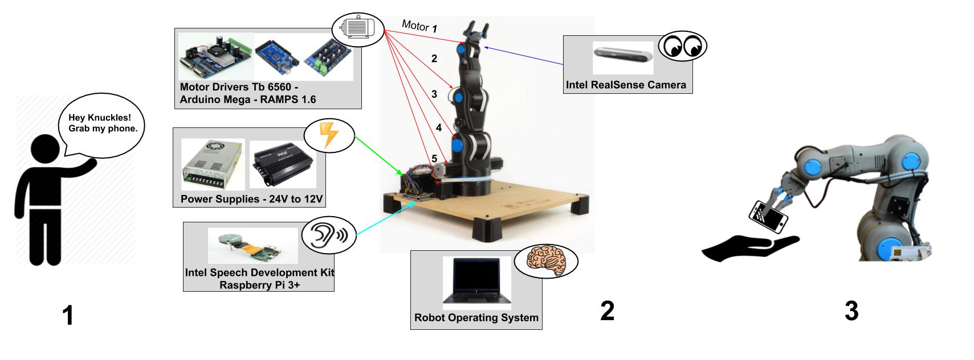
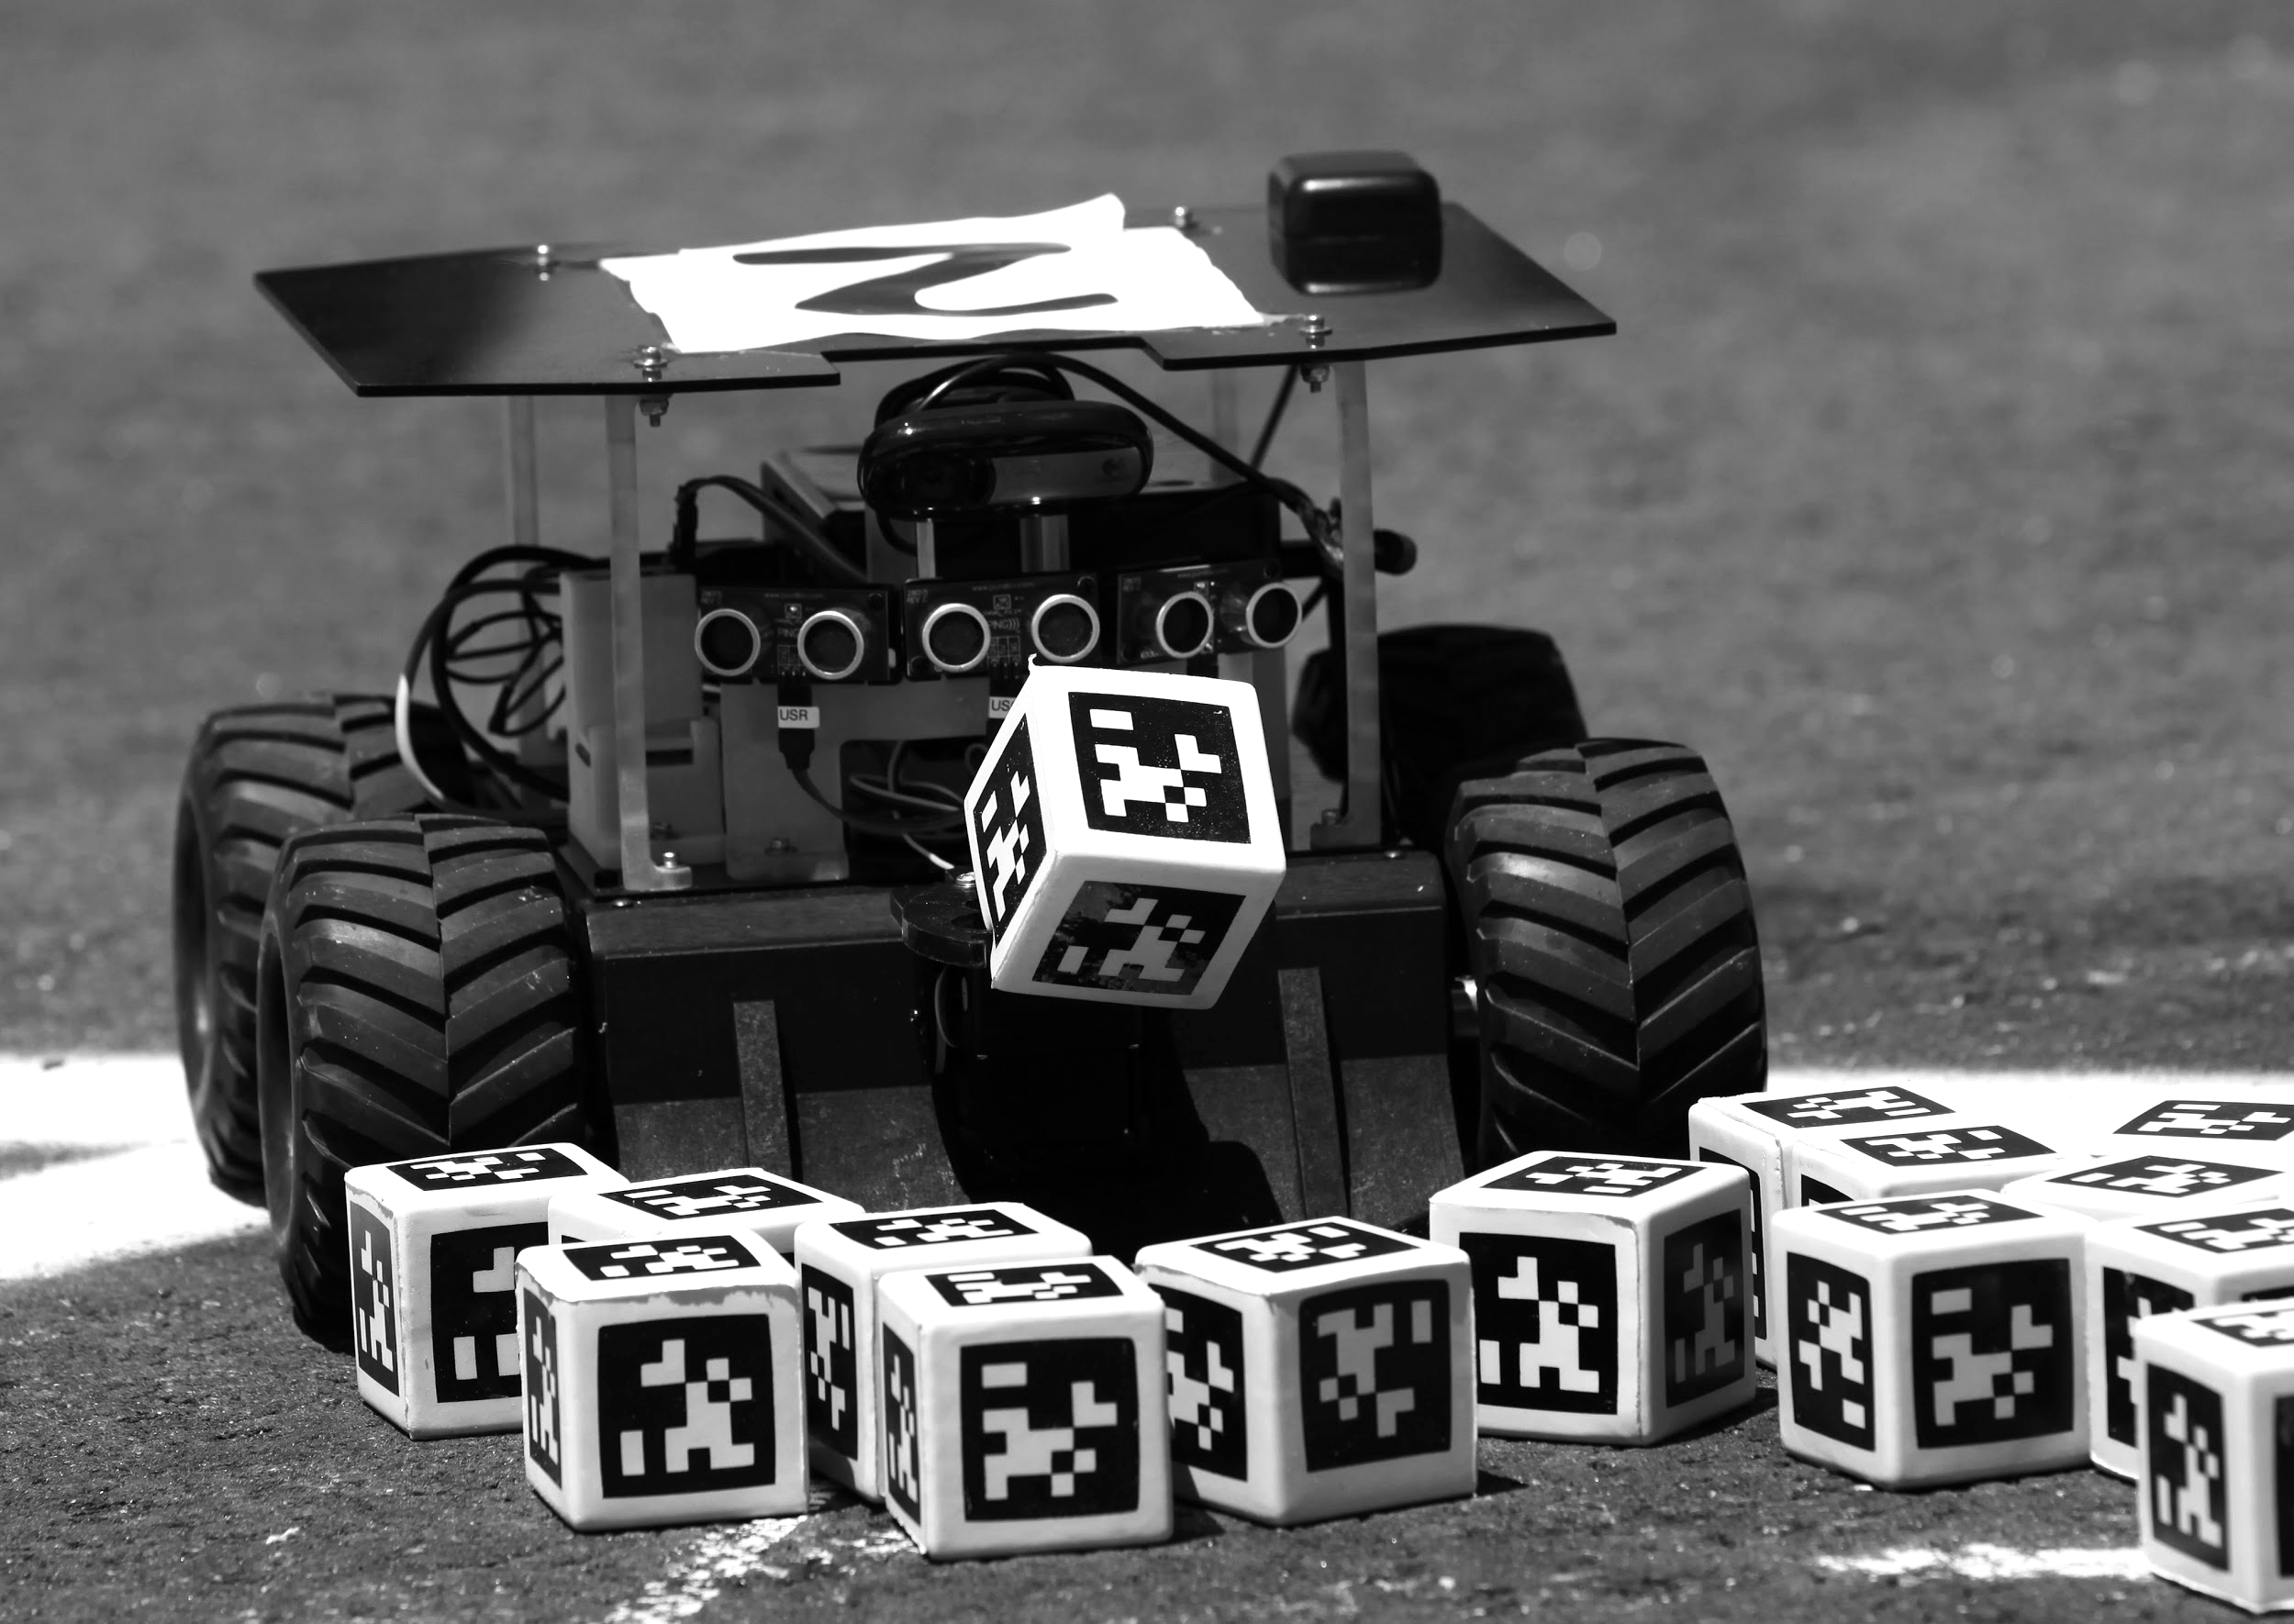

Overview Diagram
AprilTags
Figure 1. Overview of Knuckles functionalities
Notes:
Andrew

Slide 4
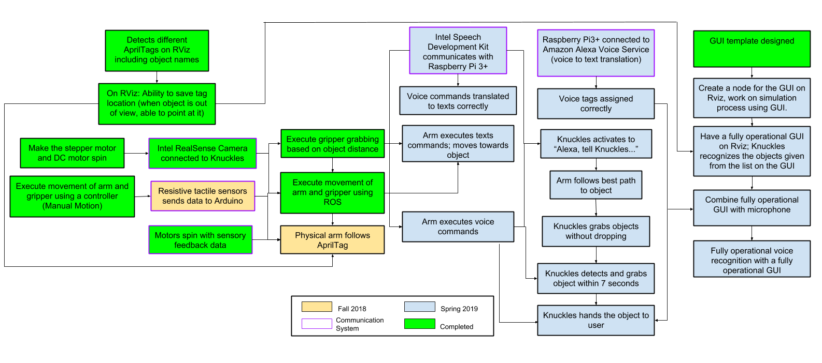
Target Objective - Goal Analysis
Figure 2. Goals and work progress
Notes:
Andrew

Slide 5
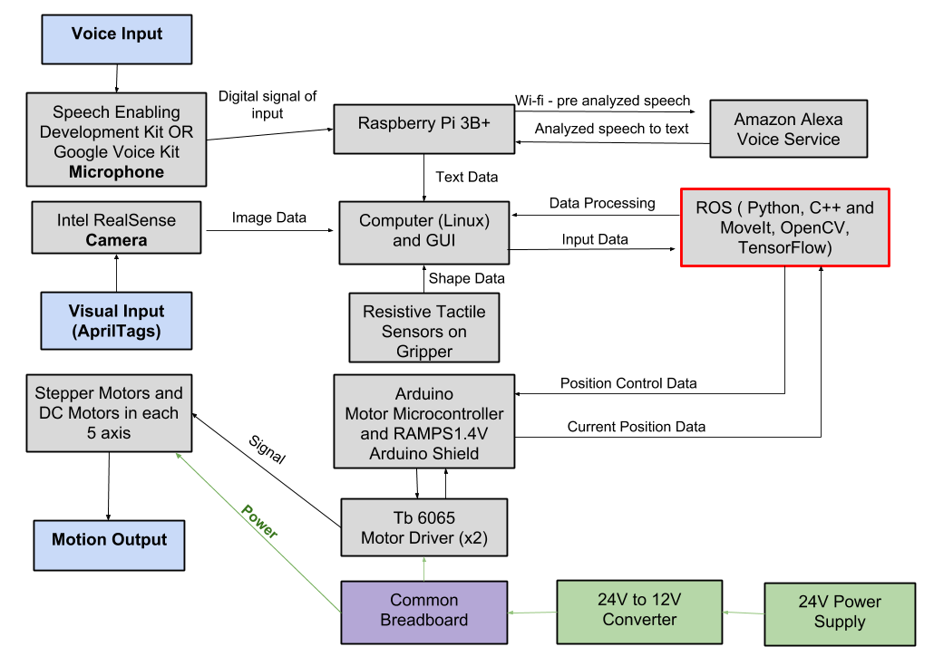
Design Considerations
Figure 3. Modular Diagram of Knuckles system
Notes:
Matthew

Slide 6
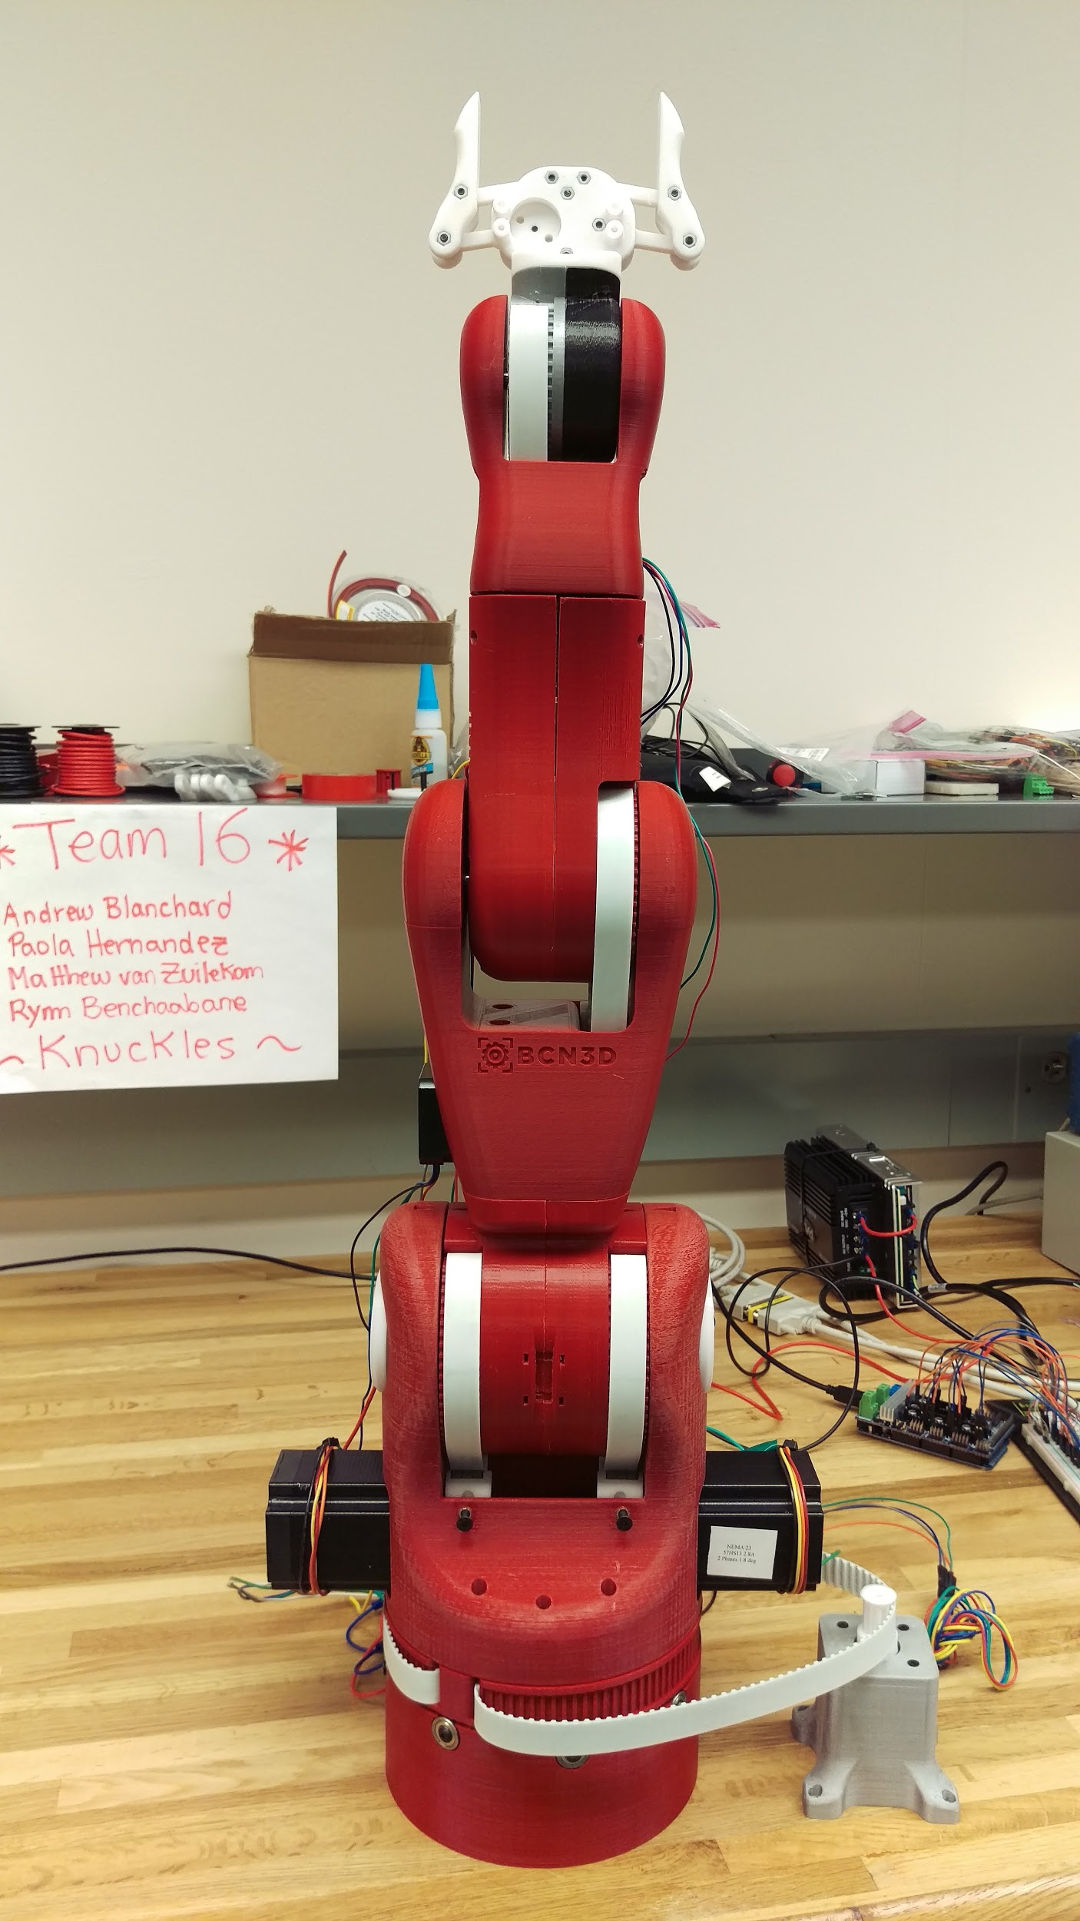
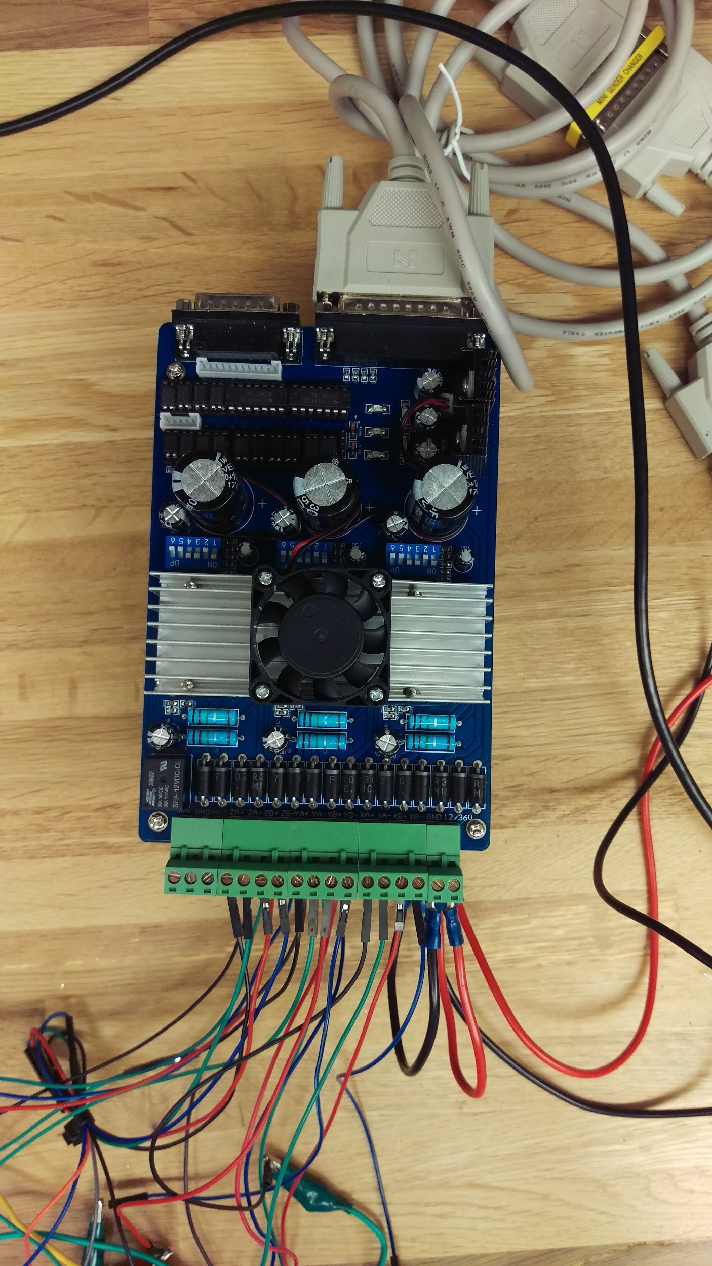
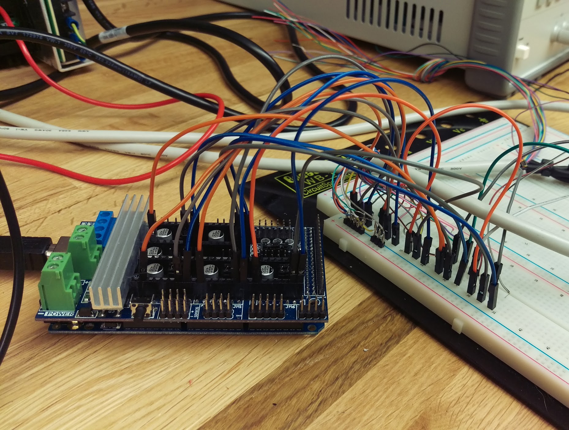
Figure 4. Arduino Mega 2560 + RAMPS V1.6 Pins connect to serial port inputs
Figure 5. Tb6560 stepper drivers
Figure 6. Knuckles, the robotic arm
Notes:
Matt

Slide 7
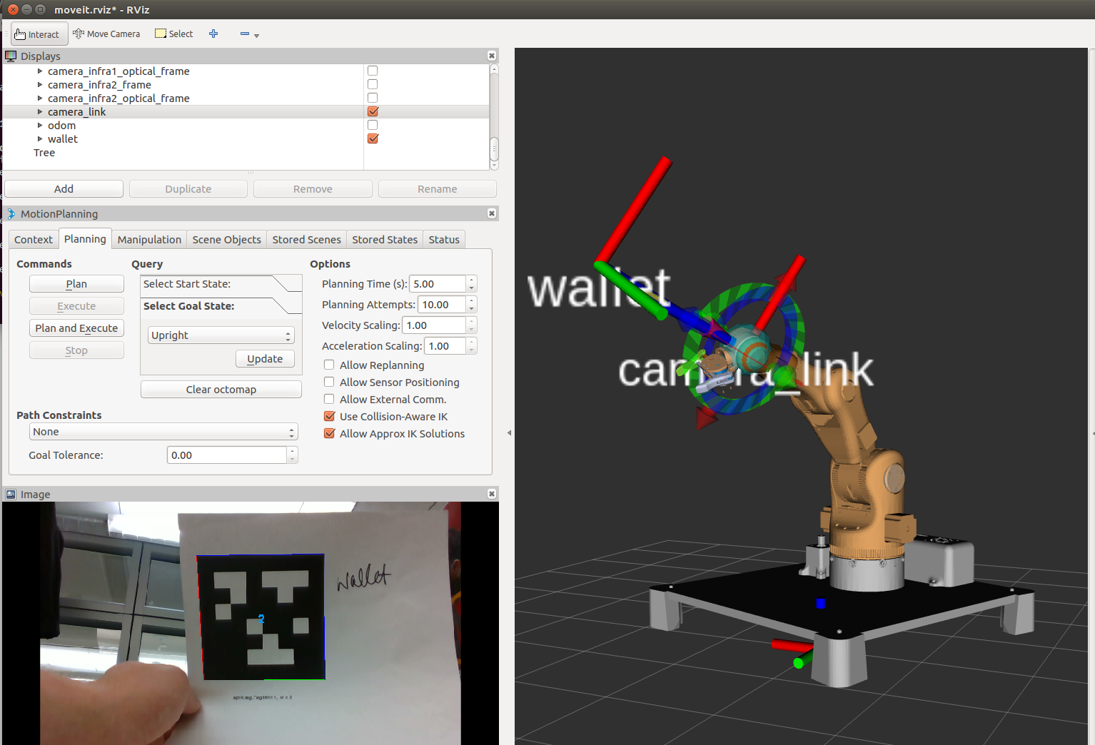
Figure 7. Knuckles model & AprilTag visualization on Rviz, ROS
Notes:
Matt

Slide 8
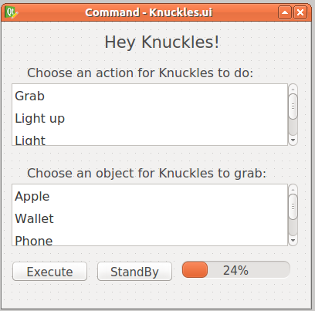
Graphical User Interface
(GUI)
Actions List:
Grab
Light Up
Light
Turn on Light
Place
Release
Take
Sleep
Object List:
Apple
Wallet
Phone
Banana
Tape
Bottle
AprilTag Cube
Bag of Chips
Notes:
Paola

Slide 9
Design Constraints
Limited time
Less time to optimize the gripper design to accommodate more shapes
Limited weight to lift
Overheated motors
Notes:
Matt

Slide 10
Specifications
Degrees of Freedom (DOF) Arm – Five
Accuracy Voice Interpretation – 70%
Minimum Voltage for Motors – 12V
Object Detection – AprilTags
Object Count Library – 8
Responsiveness Range – 4 meters
Response Time – 7 seconds
Maximum Grabbing Reach – 0.7 meters
Maximum Weight Rating – 0.5 kG
Notes:
Matthew

Slide 11
Features
Powered by Mains – Yes
Integrated Microphone – Yes
Integrated Camera – Yes
Object Detection – AprilTags
Voice-Controlled using Alexa Voice Service – Yes
GUI-Controlled – Yes
Wi-Fi required – Yes
Notes:
Matthew

Slide 12
Deliverables
Table 1. Deliverables per semester
FALL 2018 | WINTER BREAK | SPRING 2019
Assembling: Physical arm and gripper prototype 1 (100%) | Assembling: Tune gripper and arm motors motion (90%) | User Interface: Develop a Graphic User Interface (QTdesigner) (20%)
Hardware Purchased: (Intel RealSense camera, Intel mic, tactile pads) (100%) | Hardware Implementation Mount and install on Arm (Intel RealSense camera, Intel mic, tactile pads) (50%) | Automation Control: Arm moves using data from ROS (50%)
Object Detection: Recognize the AprilTag and associate it to an object (100%) | Object Detection: Arm follows the AprilTag (90%) | Voice Recognition: Convert voice to speech speech to object detection (15%)
Simulation: Arm functions on RViz (100%) | Communication System: Receive Feedback Signals from all hardware on ROS (33%) | Physical arm Prototype 2 (75%)
Notes:
Andrew

Slide 13
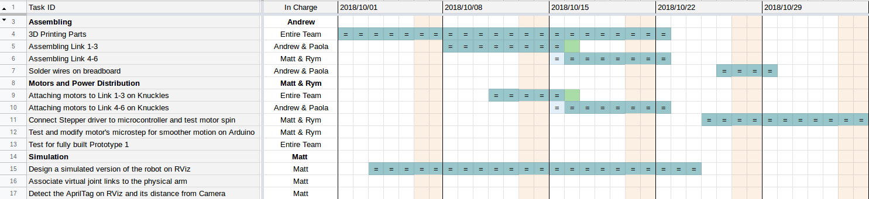
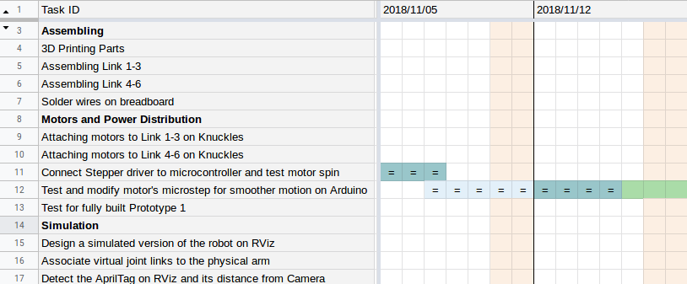
Gantt Chart - Fall
LEGEND
Completed
Delay
In Progress/Incomplete
Notes:
Rym, also talk about Test Plan

Slide 14
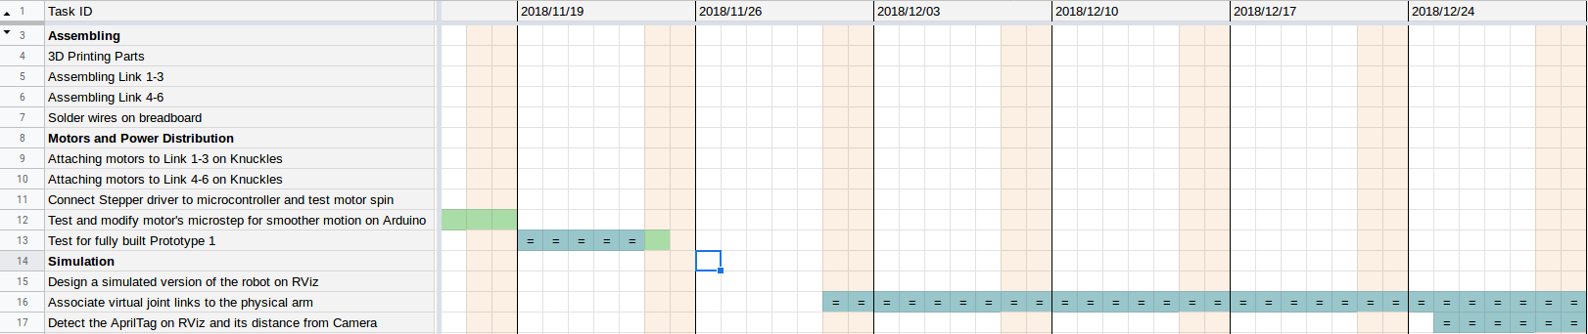
Gantt Chart - Fall
LEGEND
Completed
Delay
In Progress/Incomplete
Notes:
Rym, also talk about Test Plan

Slide 15
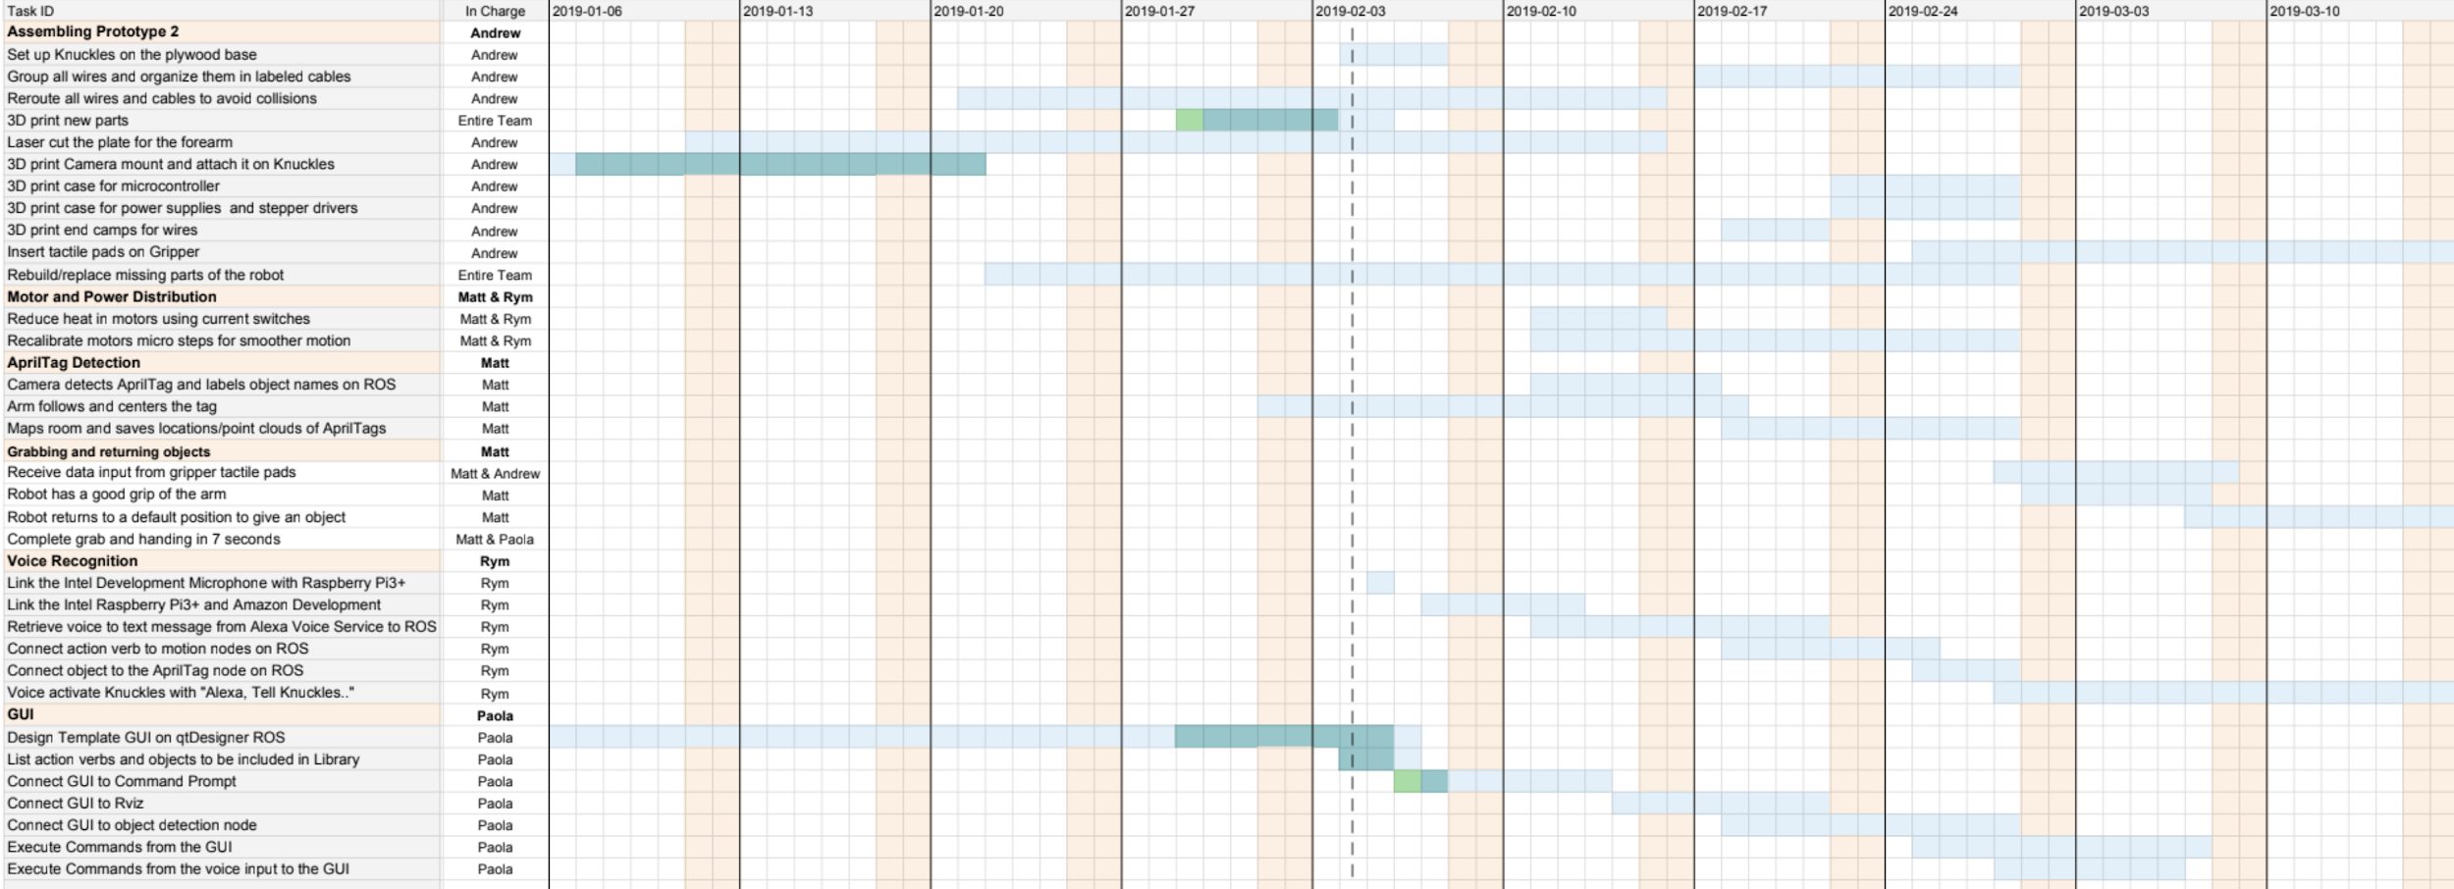
Gantt Chart - Spring
Notes:
Rym, also talk about Test Plan

Slide 16
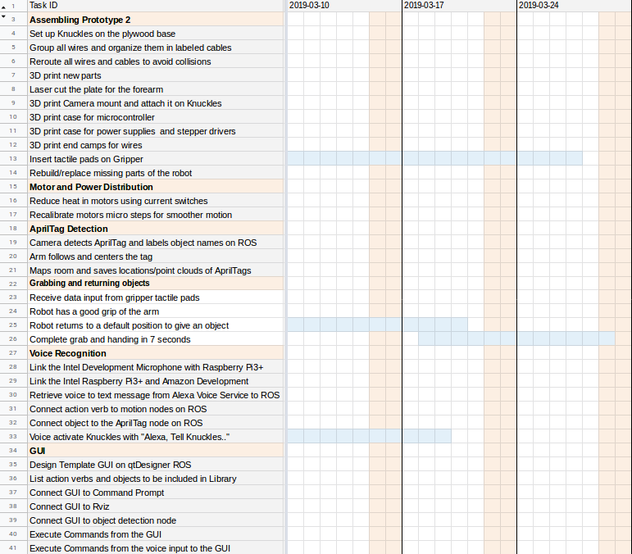
Gantt Chart - Spring
LEGEND
Completed
Delay
In Progress/Incomplete
ECEDHA Conference
Deadline
Notes:
Rym, also talk about Test Plan

Slide 17
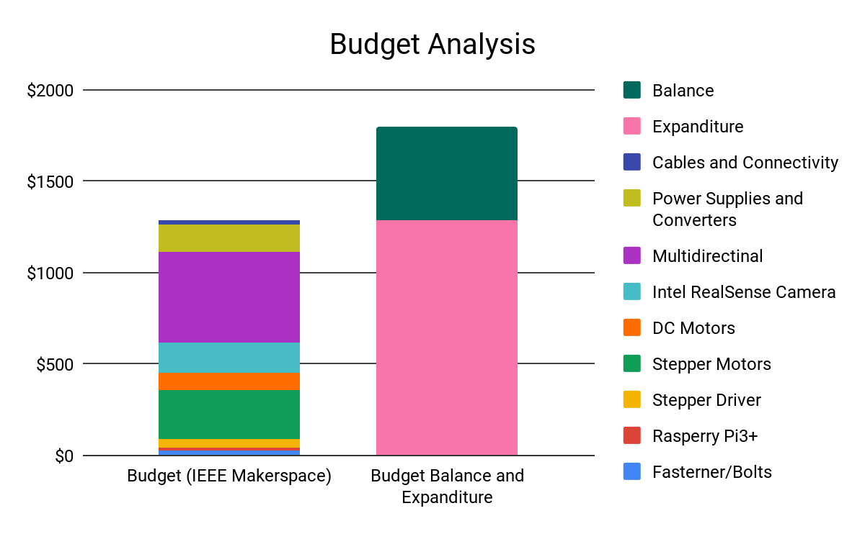
Total Budget
Thank you MakerSpace, Dr. Roysam & Dr. Becker
.
Total Budget: $1,800
Used 70.2%
Figure 9. Budget Table

Slide 18
Project Conclusion
Assistive robotic arm, increase productivity
Great opportunity to learn about robotics, Linux & ROS
Test plan
Modular plan will help us accomplish our goals
Current progress
Used 70.2% of budget
Working on 2nd prototype
Notes:
Rym

Slide 19
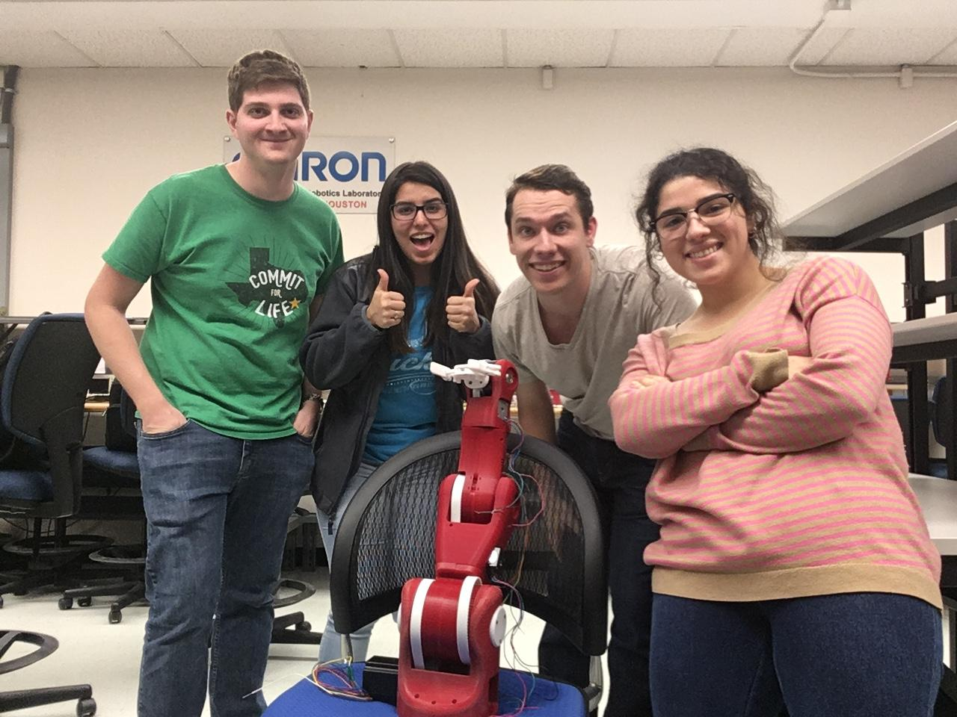
Thank you for your attention
QUESTIONS?
Notes:
Yay

